Slide 1

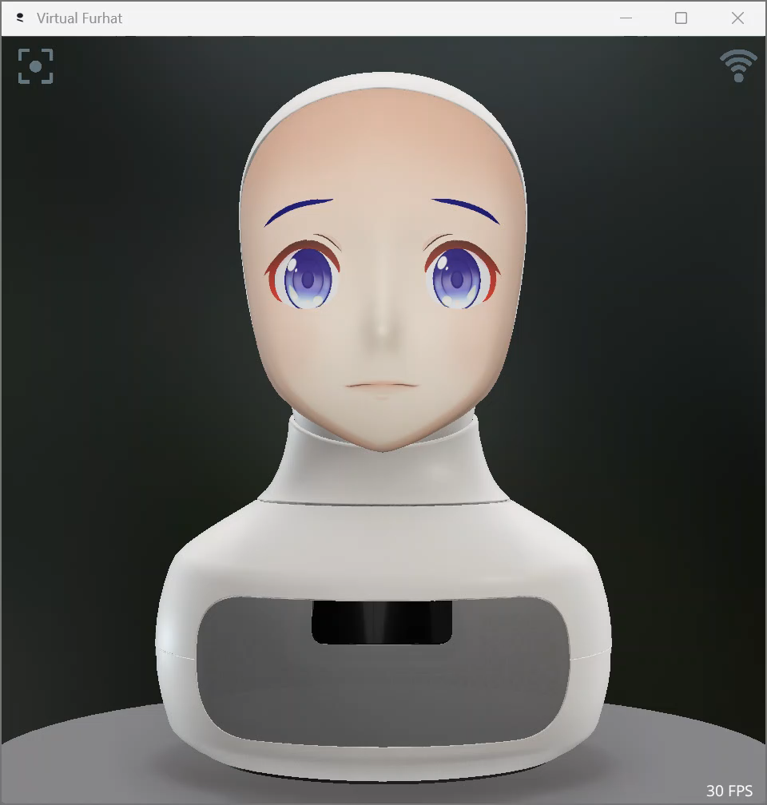
Personalized
Social Interaction
With Furhat

Slide 2
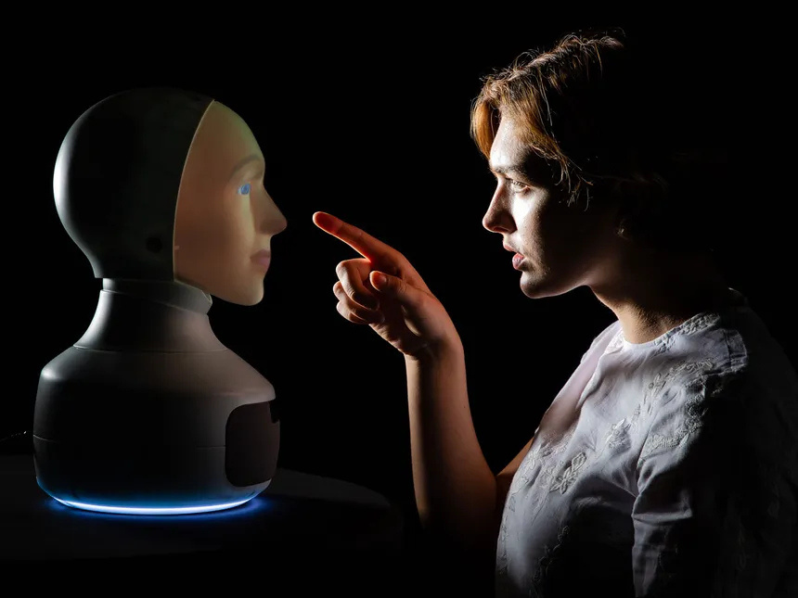
Project Objective
Explore and enhance the dynamics of personalized social interactions between humans and the Furhat robot.
Utilize voice recognition for user identification and emotional state analysis.
Analyzing the emotions of the user and giving adaptive responses.
Evaluate the effectiveness of a random topic suggestion system in maintaining engaging conversations.

Slide 3
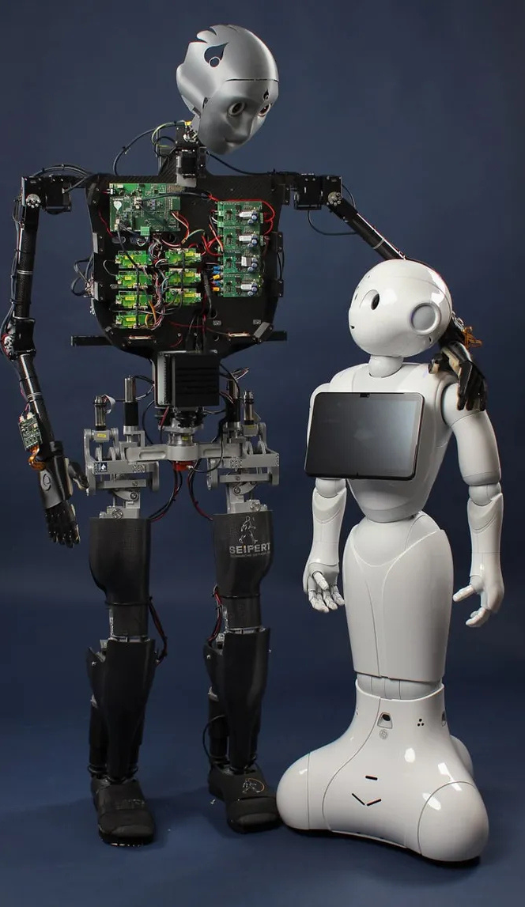
Technologies Used
Furhart Sdk SDK (Enable the audio feed on your Furhat robot via the web interface (Settings > External Feeds),
01
02
Languages Used : Kotlin, Python
03
Voice recognition Model
04
IntelliJ IDE

Slide 4
Research Question and Hypothesis
How accurately does the voice recognition system identify individual users in real-time, and what impact does accurate identification have on user satisfaction and perceived personalization?
RQ1
Hypothesis 1: The voice user identification algorithm will achieve an identification accuracy rate of at least 80% when using voice data, accounting for variations in speech patterns and environmental noise.
Hypothesis 2: Higher accuracy in user identification will correlate positively with user satisfaction levels, as it enables a more personalized and contextually relevant interaction experience.
HYP

Slide 5
Research Question and Hypothesis
How does the topic suggestion system influence user engagement, and what role does the avoidance of previously discussed topics play in maintaining user interest over extended conversations?
RQ2
Hypothesis 1: The topic suggestion feature, designed to avoid previously discussed topics, will lead to longer conversation duration and increased user engagement.
Hypothesis 2: Avoiding repetitive topic suggestions will result in higher user interest and perceived novelty, enhancing overall interaction satisfaction.
HYP

Slide 6
Implementation Approach
•Voice Recognition for User Identification: User’s audio processed and identified; name saved and used for greeting.
•Emotion Detection and Response: Emotion analysis triggers corresponding responses based on user input.
•Audio Streaming and Recording: Real-time streaming and recording of conversations for analysis.
•Multi-User Interaction and Topic Engagement: Furhat engages with users individually in a sequential manner, ensuring focused and personalized interactions with each user before moving to the next

Slide 7
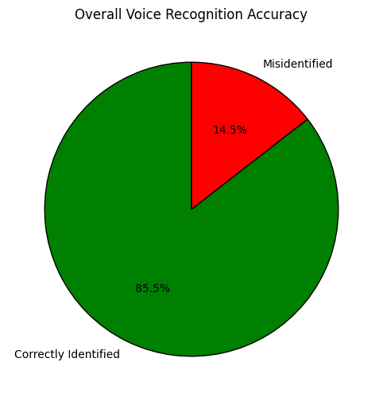
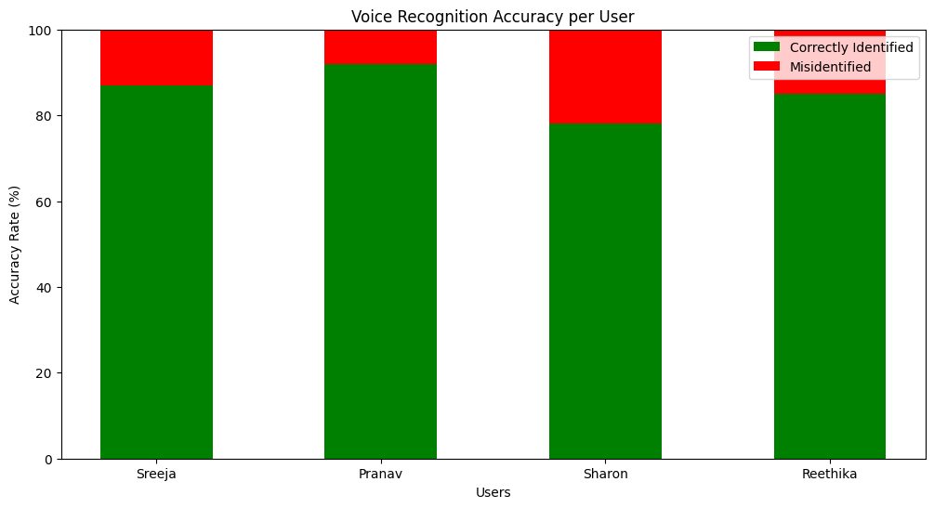
Metrics Analyzed
Identification Accuracy: Frequency of correct user identification

Slide 8
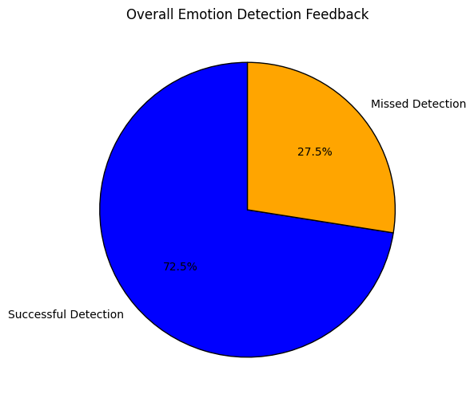
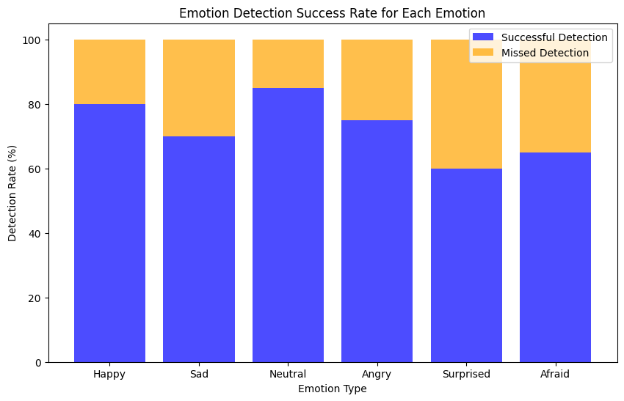
"Emotional Response Accuracy: Measuring the correctness of Furhat’s emotional responses based on user input."

Slide 9
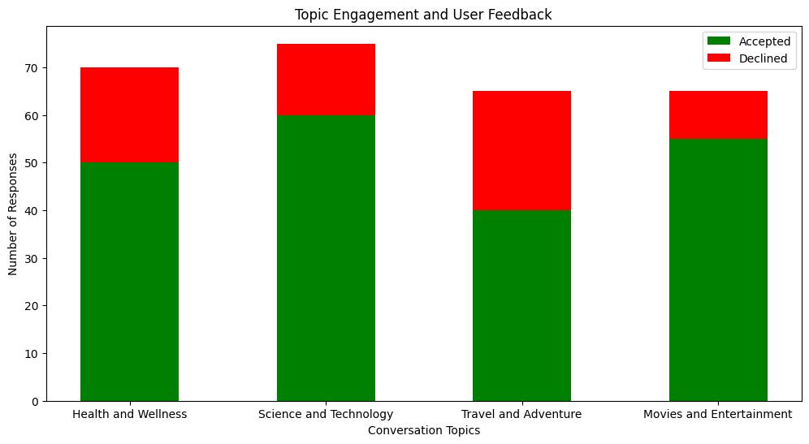
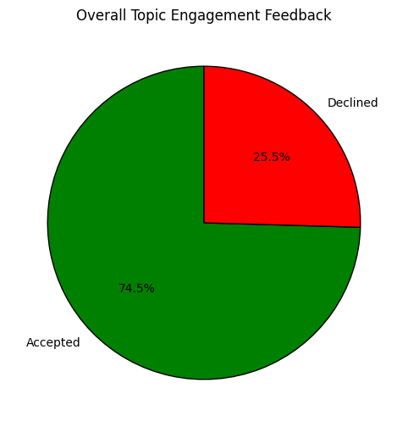
"User Engagement: Measuring the length and quality of conversations following topic suggestions."

Slide 10
User Perceptions:
Each user participated in an interaction with the Furhat robot. After the interaction, their perceptions were evaluated using two standardized measurement tools: the Godspeed Scales and the ROSAS Scale. These tools helped assess various dimensions of user experience and engagement.
Godspeed Scales: Anthropomorphism, Animacy, Likability, Intelligence, and Safety.
ROSAS Scale: Perceived Usefulness, Emotional Engagement, Perceived Adaptivity, and Enjoyment.

Slide 11

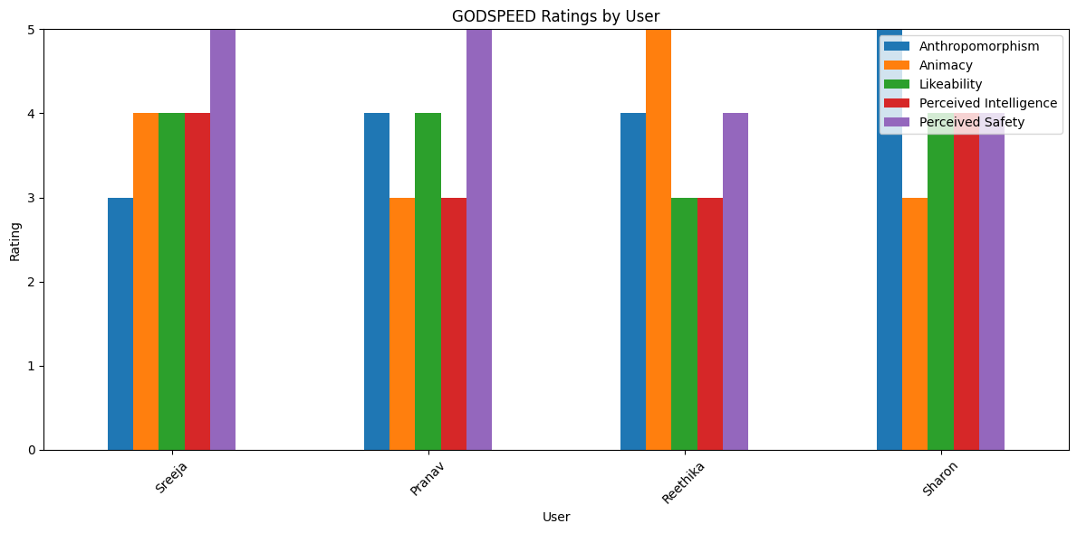

Slide 12

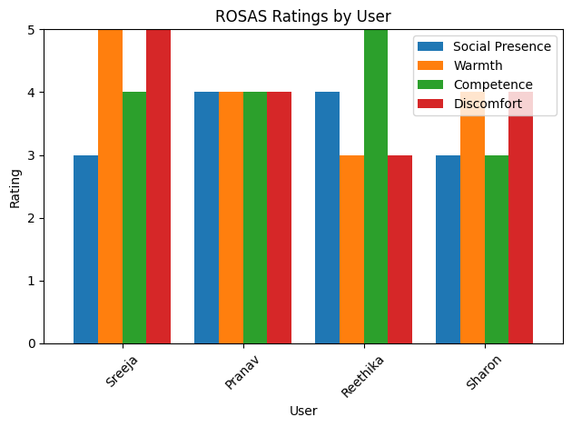

Slide 13
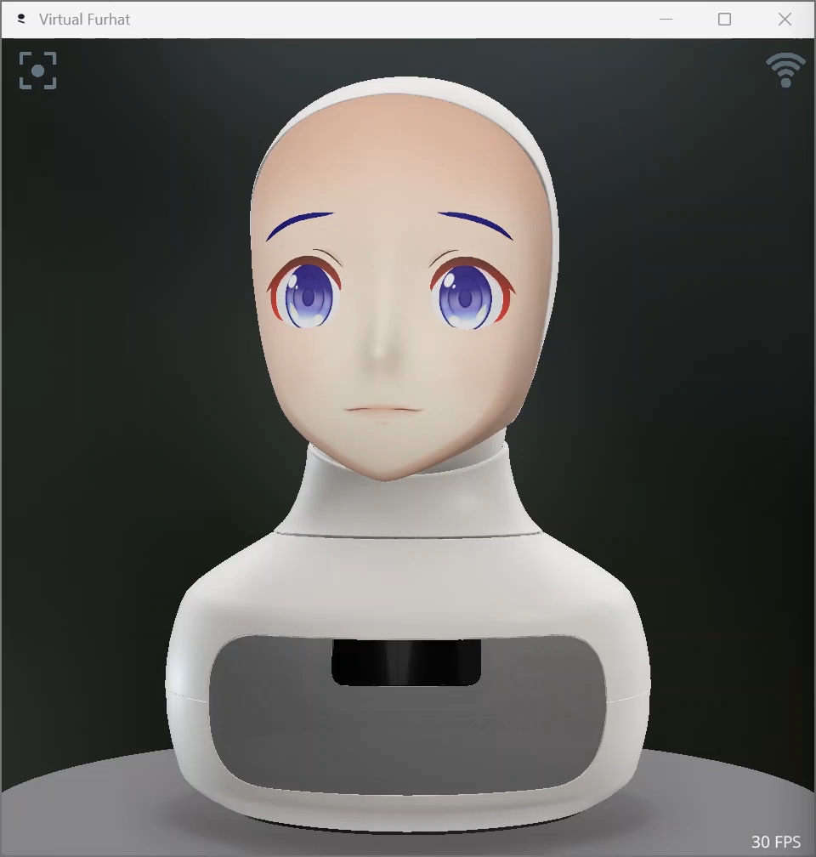

Slide 14
Thank You

